Slide 1
Here's your outline to get started
Key facts about your topic
African-American businesses, also known as Black-owned businesses or Black businesses, originated in the days of slavery before 1865. Emancipation and civil rights permitted businessmen to operate inside the American legal structure starting in the Reconstruction Era and afterwards. By the 1890s, thousands of small business operations had opened in urban areas. The most rapid growth came in the early 20th century, as the increasingly rigid Jim Crow system of segregation moved urban Blacks into a community large enough to support a business establishment. The National Negro Business League—which Booker T. Washington, college president, promoted—opened over 600 chapters. It reached every city with a significant Black population.
See more: Open the Notes below for more information.
Notes:
QuickStarter has created an outline to help you get started on your presentation. Some slides include information here in the notes to provide additional topics for you to research.

Slide 2
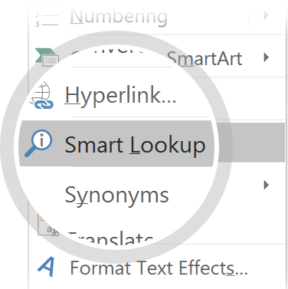
Related topics to research
Madam C. J. Walker
Booker T. Washington
National Negro Business League
Reginald Lewis
Berry Gordy
John H. Johnson
Alonzo Herndon
Marjorie Joyner
Robert Lee Vann
Anthony Overton
Use Smart Lookup to learn more
1
Highlight one of the related topics
Right-click on the topic
Choose "Smart Lookup"
2
3

Slide 3
DreamLeapers Virtual Conference
Leaping into YOUR What’s Next…

Slide 4
Exploring the Possibility of Entrepreneurship as YOUR What’s Next
What IF?

Slide 5
Let’s Explore the Possibilities
IF money was not an issue and you wanted to launch an entrepreneurial endeavor, what would that be?

Slide 6
Did You Know?
Older entrepreneurs are the most successful among all owners, founders, innovators.
Older entrepreneurs bring wisdom, knowledge, expertise and years of experience to entrepreneurship
Pre-pandemic recent years, women were the fastest growing segment of new entrepreneurs.
Amid the pandemic, women were the starters of new businesses.

Slide 7
Entrepreneurship…NOW!
“There is no better time like the present”…in spite of our current environment
Opportunity to turn your passion/skill into profit
Opportunity to turn your years of experience into a moneymaking endeavor
Time is NOW your friend
Simply…You have so much to offer
Notes:
So yes, NOW is the your time.

Slide 8
What Entrepreneurship Looks Like…
Freelancing
Side Hustle
Passion Project
Small Business

Slide 9
Things to Consider…
Product or Service Idea
Who’s Your Target Audience
Sales and Marketing
Digital Presence
Training
Mentoring
Funding

Slide 10
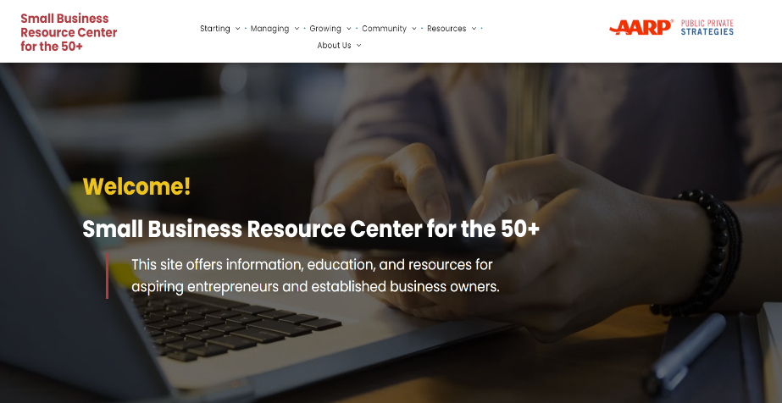
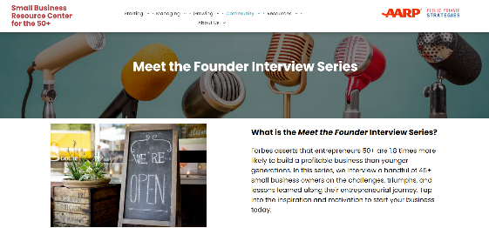
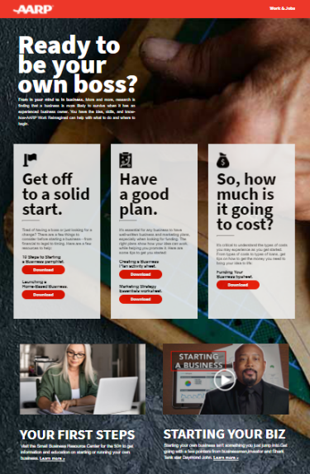
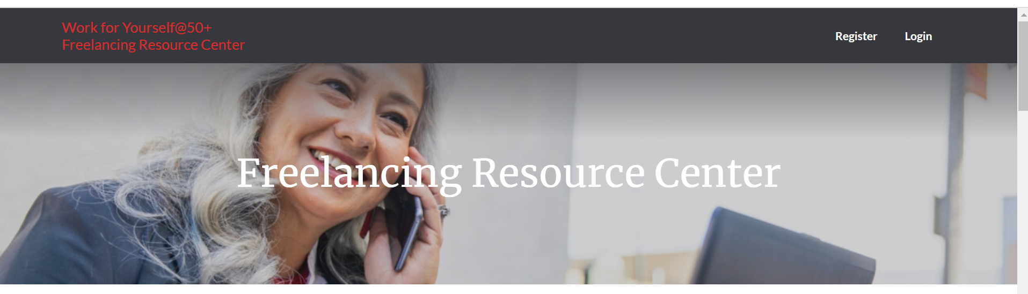
AARP Entrepreneurship Resources
AARP is here help…
Resource Links
AARP Start A Business
www.aarp.org/startabusiness
Small Business Resource Center for the 50+
(www.smallbizrc.org)
Be Your Own Boss
(www.aarp.org/beyourownboss)
AARP FDN Freelancing Resource Center
Freelancing.aarpfoundation.org
LinkedIn…Meet the Founders

Slide 11
External Resources
Small Business Administration
Small Business Development Centers
Women’s Business Development Centers
National Urban League Entrepreneurship Center

Slide 12
Now is YOUR time!

Slide 13
Questions
Email Felicia Brown at fbrown@aarp.org OR LinkedIn

Slide 14
A Place for You…

Slide 15
Notes:
Speaker Notes: Thank you for joining us, and we hope to see you again soon at another AARP presentation.

